Slide 1
Bridge Design Pattern
Brett Recker
Radwan Albadawi

Slide 2






Story
Bridge design pattern separates an object’s interface from its implementation
Progressively adding functionality while separating out major differences using abstract classes
Changes in the abstraction won’t affect the client
Notes:
A real world example of this is devices and remote controllers. The device classes act as the implementation and the remotes act as the abstraction. The base remote class is linked with a device object, thus creating our bridge. We can define high level controls in the remote abstraction such as power on/off and volume up/down. The corresponding methods can be defined in the base device class. From there, you can extended the base remote class for more specific devices. A DVD remote can be extended to pause/play, rewind/fast forward, etc. Whereas, a TV remote might have the ability to change channels or mute.
This design patterns allows you to change or add new classes without touching the opposite hierarchy.

Slide 3
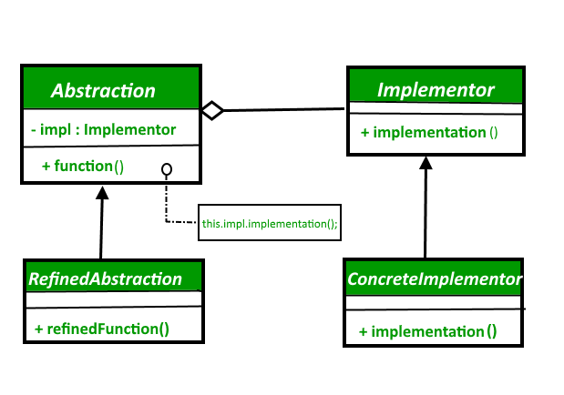
UML Design
Notes:
There are separate hierarchies for the abstraction and implementor making them independent of each other. The abstraction defines the abstract interface and maintains the implementor reference. This can be extended through the RefinedAbstraction. The implementor defines the interface for the implementation classes. The ConcreteImplementor inherits from the Implementor and defines additional functionality.

Slide 4
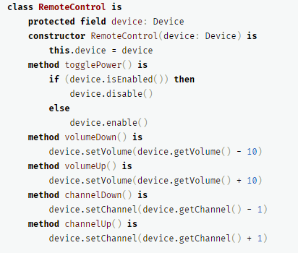
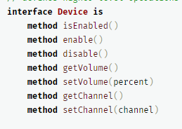
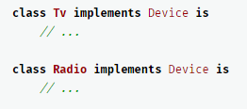

Code
Abstraction
Implementation
Notes:
The RemoteControl abstraction defines the interface for control of the both hierarchies and maintains a refence to an object from the implementation hierarchy where all the work is performed. This abstraction can be extended like AdvancedRemoteControl with additional methods independently from the device hierarchy. The Device interface is an implementation interface where all the common methods are declared. This does not have to match the abstraction’s interface but all concrete implementors such as TV and Radio must follow this interface.
https://refactoring.guru/design-patterns/bridge

Slide 5
Quiz
What are the two hierarchies in the Bridge Design Pattern?
Is the implementor class affected when a refined abstraction is added?
Where is the highest level of functionality defined in this design pattern?
Notes:
Abstraction and Implementation
No, this is the main benefit of the Bridge Design Pattern.
The Abstraction provides high-level control logic and relies on the implementation object to do the actual low-level work.

Slide 6
Sources
https://sourcemaking.com/design_patterns
https://www.geeksforgeeks.org/bridge-design-pattern/
https://refactoring.guru/design-patterns/bridge

